Slide 1
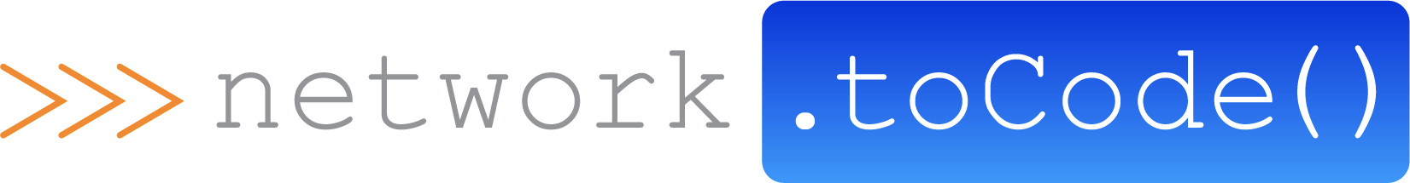
Network Automation Platform vs Power Tools
Damien Garros, Managing Director, Network to Code

Slide 2
Agenda
Introduction
Power Tools
Network Automation Platform
Summary

Slide 3
Power Tools

Slide 4





Traditional Network Operations

Slide 5
[Common] Starting Point
Old school scripting
CLI & GUI
Python scripts
Ansible playbooks
backups.pl
vlans.pl
MySQL
Custom web app in PHP
Saved on local disk
get_neighbors.py
vlan_check.py
deploy.yml
Git Push (force)

Slide 6


Create a Strategy
The critical decision
Platform
Power Tools
Platform
Nucleus for all network automation
Extensible and modular
Enterprise controls
Makes tasks easy for admins
Disparate scripts
Limited to no data integration

Slide 7
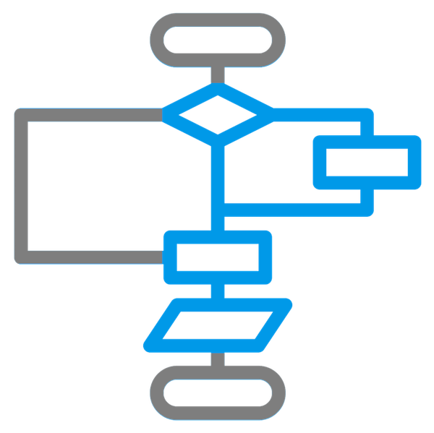

What is Network Automation?
Tools
Workflows
Data

Slide 8
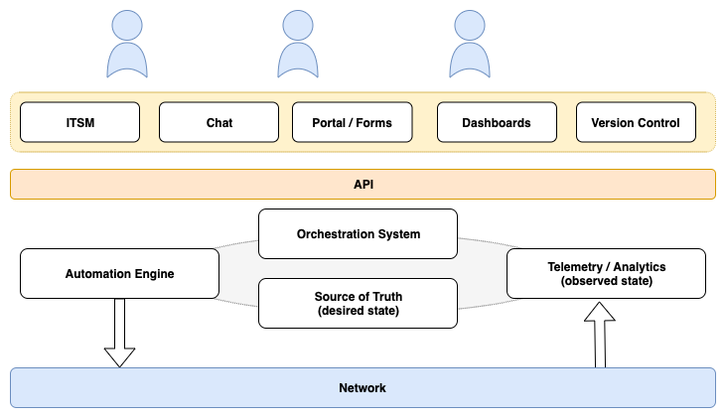
Network Automation Framework

Slide 9
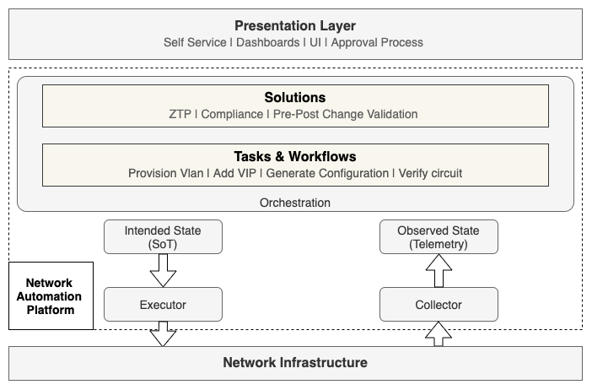
Network Automation Framework

Slide 10
Network Automation Platform

Slide 11
Network Automation Framework

Slide 12
Intended State/ Source of Truth
Role: | Store and organize the intended/desired state of the network
Inventory
Cabling
Routing Protocols
Configuration Templates
Applications Directory
IP Addresses
ACL
Circuits
Rack Physical
Software Standard
Vlans
Intended Operational State
Device Properties
Status and Roles
Servers

Slide 13
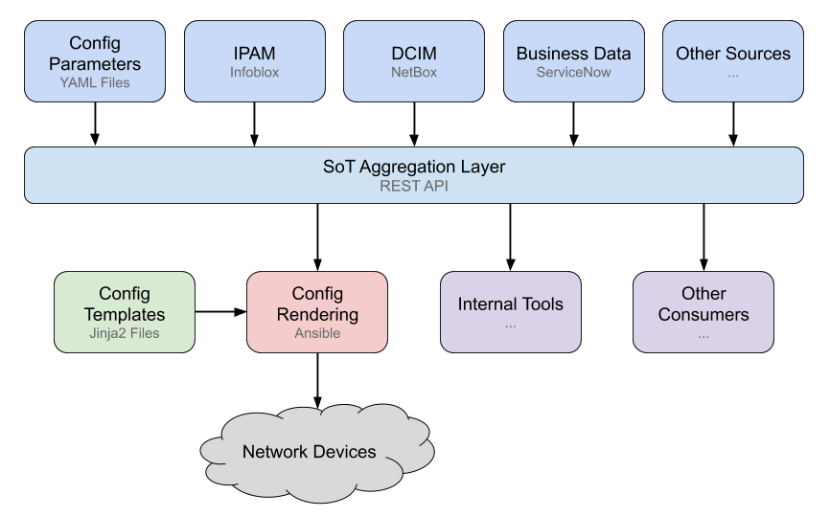
Source of Truth Aggregation

Slide 14
Intended State/ Source of Truth
Role: | Store and organize the intended/desired state of the network
Key Attributes:
Guarantee accuracy of the data
Provide traceability, history of the SoT
Provide atomic changes
Ease of access to the data
Capture the relationship between the object

Slide 15
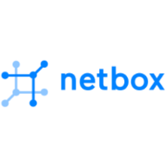




Intended State/Source of Truth
Role: | Store and organize the intended/desired state of the network
Examples:

Slide 16
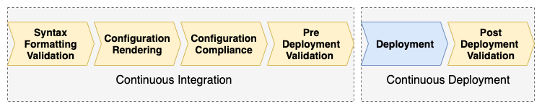
Executor/Automation Engine
Role: | Interact with the network, render and deploy configurations

Slide 17
Executor/Automation Engine
Role: | Interact with the network, render and deploy configurations
Key Attributes:
Simplify interact with network devices
Abstract vendor specific APIs/Interface
Authentication
Performance

Slide 18
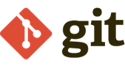
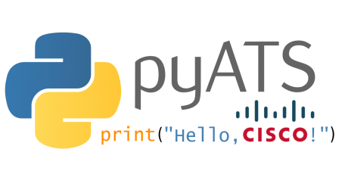



Executor/Automation Engine
Role: | Interact with the network, render and deploy configurations
Examples

Slide 19

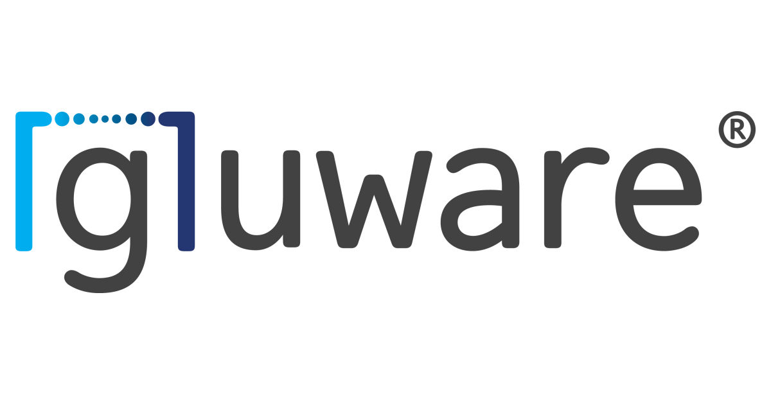

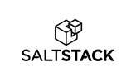

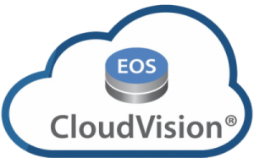
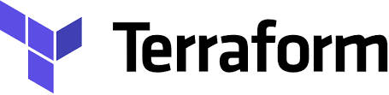
Executor/Automation Engine
Role: | Interact with the network, render and deploy configurations
Examples
Nornir

Slide 20
Network Automation Framework

Slide 21
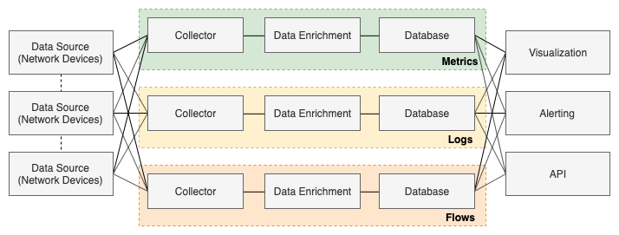
Telemetry and Analytics
Role: | Provide visibility into the current and past state of the network, in a meaningful way.

Slide 22
Collector
Role: | Extract the current state of the network
Key Attributes:
Easily query all states from the network
Easily add new information to the collection pipeline
Insert business metadata to the data as needed
Scalable and Resilient
Support multiple types of data/interfaces (SNMP/ CLI / gNMI / Flows / Logs)

Slide 23



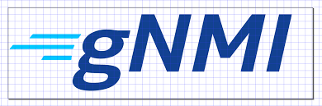
Collector
Role: | Extract the current state of the network
Examples

Slide 24
Observed State
Role: | Store the current and past state of the network
Key Attributes:
Ease to query current and paste state of the network
Ingest large volume of data
Store business metadata
Support all types of data (metrics, logs, structured ..)

Slide 25
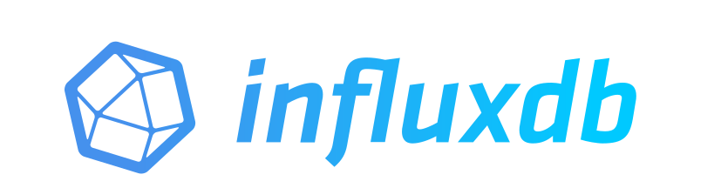



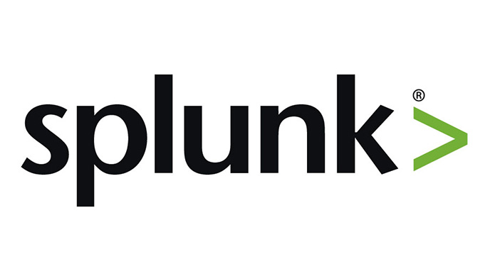
Observed State
Role: | Provide visibility into the current and past state of the network
Examples

Slide 26
Network Automation Framework

Slide 27
Orchestration System
Role: | Define & execute customer specific workflows

Slide 28


Workflow is the new power tool
Power tools and quick wins get integrated as workflows automated by the platform
Power Tools
Platform
Platform

Slide 29
Orchestration System
Role: | Define & execute customer specific workflows
Key Attributes:
Ease to define all workflows, simple and advanced
Traceability & troubleshooting of past workflows execution
Integration with multiple data sources

Slide 30

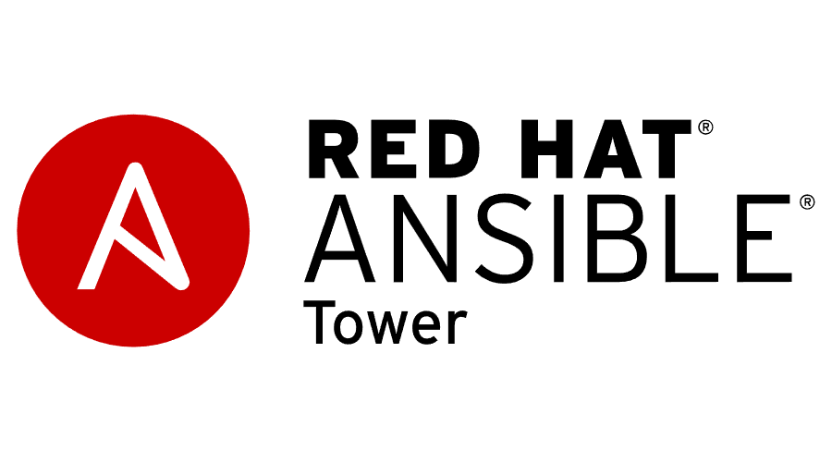



Orchestration System
Role: | Define & execute customer specific workflows
Examples:

Slide 31
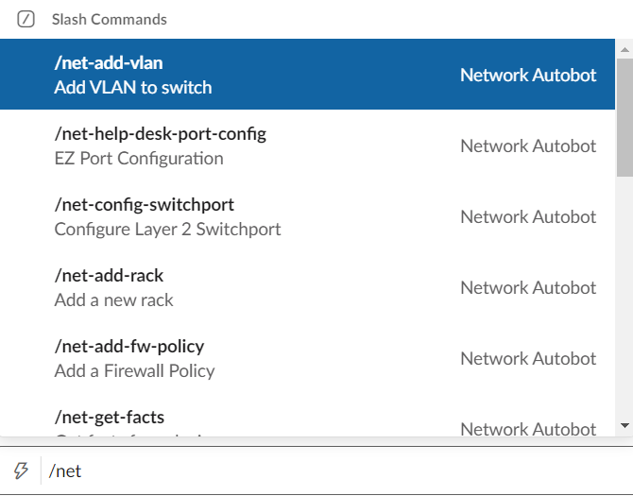
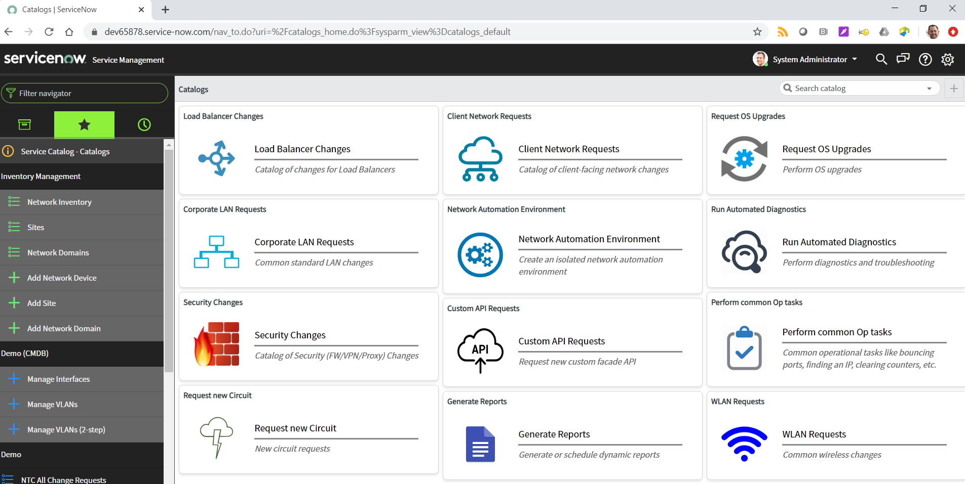
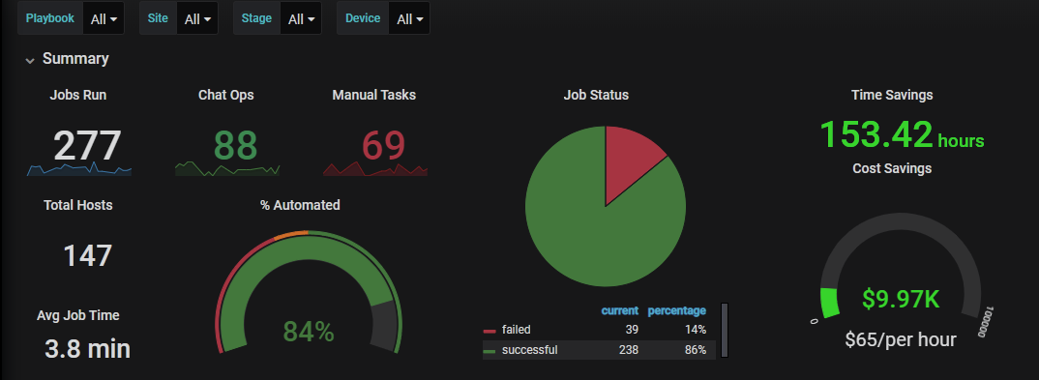
User Interface / Presentation Layer
Role: | Provide the best UI to the users and integrate with existing tools
ITSM
Chat
Dashboards

Slide 32
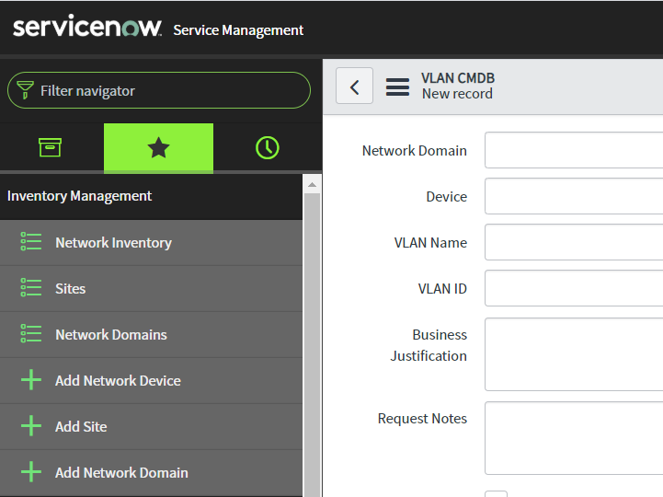
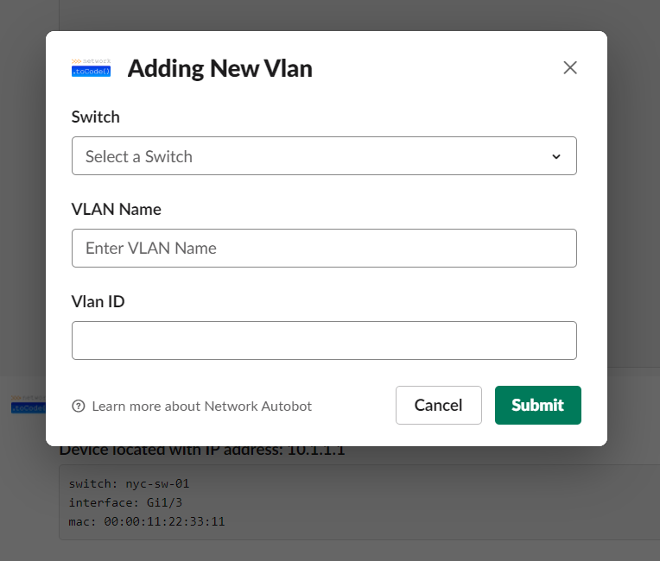
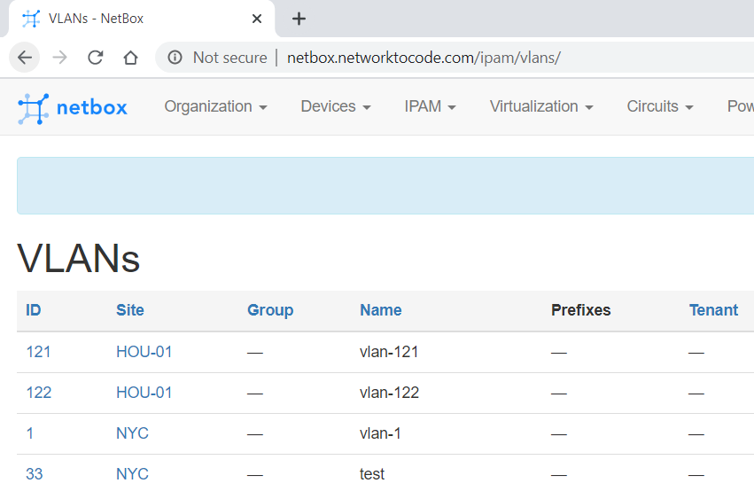



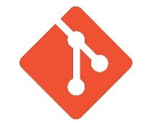
One workflow, multiple interfaces
Not all workflows have to be delivered the same way
It’s best to examine the target user and find the best presentation layer for them so it’s an optimal user experience
ServiceNow Form
Direct from Chat
Webhook from Source of Truth
Direct from IT Ops Workflows

Slide 33
User Interface / Presentation Layer
Role: | Provide the best UI to the users and integrate with existing tools
Key Attributes:
Integrate with ITSM Platform & CMDB
Integrate with Chat system
Allow creation & distribution of user defined dashboards
Self-Service

Slide 34
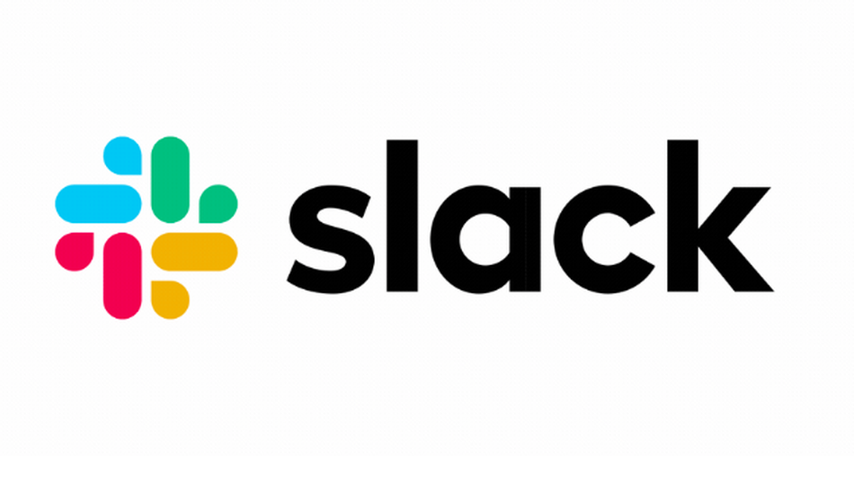





User Interface / Presentation Layer
Role: | Provide the best UI to the users and integrate with existing tools
Examples

Slide 35
Network Automation Framework

Slide 36
Platform
Role: | Easily develop and maintain the components of the platform
Key Attributes:
Version Control
Continuous Integration / Unit Test
Scale
Security
Logging/Maintainability

Slide 37
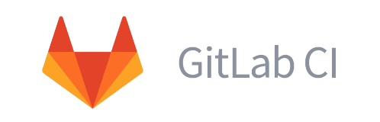



Platform
Role: | Easily develop and maintain the components of the platform
Examples

Slide 38
Summary
Network Automation is about Workflows and Data (Intended and observed)
A Network Automation Platform :
makes data easily accessible
is meant to be consumed by Network Engineers to define workflows
A Network Automation Platform is composed of many components, assembled together.

Slide 39
Thank You

